Slide 1
Lecture 9
Constraint Satisfaction Problem
Yaohang Li
Department of Computer Science
ODU
Reading for This Class:
Chapter 6, Russell and Norvig

Slide 2
Review
Last Class
Local Search
Simulated Annealing
Genetic Algorithms
This Class
Constraint Satisfaction Problems
Next Class
Adversarial Search

Slide 3
Intro Example: 8-Queens
Purely generate-and-test
The “search” tree is only used to enumerate all possible 64⁸ combinations

Slide 4
Intro Example: 8-Queens
Another form of generate-and-test, with no
redundancies → “only” 8⁸ combinations

Slide 5
Intro Example: 8-Queens

Slide 6
What is Needed?
Not just a successor function and goal test
But also a means to propagate the constraints imposed by one queen on the others and an early failure test
→ Explicit representation of constraints and constraint manipulation algorithms

Slide 7
Constraint Satisfaction Problems
What is a CSP?
Finite set of variables V₁, V₂, …, V_{n}
Nonempty domain of possible values for each variable D_{V1}, D_{V2}, … D_{Vn}
Finite set of constraints C₁, C₂, …, C_{m}
Each constraint C_{i} limits the values that variables can take,
e.g., V₁ ≠ V₂
A state is defined as an assignment of values to some or all variables.
Consistent assignment
assignment does not violate the constraints
CSP benefits
Standard representation pattern
Generic goal and successor functions
Generic heuristics (no domain specific expertise).

Slide 8
CSPs (continued)
Completeness
An assignment is complete when every variable is mentioned.
A solution to a CSP is a complete assignment that satisfies all constraints.
Some CSPs require a solution that maximizes an objective function.
Examples of Applications:
Scheduling the time of observations on the Hubble Space Telescope
Airline schedules
Cryptography
Computer vision -> image interpretation

Slide 9
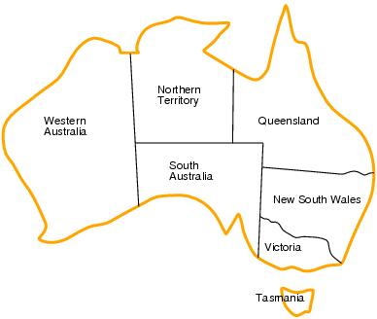
CSP Example: Map Coloring
Variables: WA, NT, Q, NSW, V, SA, T
Domains: D_{i}={red, green, blue}
Constraints: adjacent regions must have different colors.
WA≠NT, WA≠SA, NT≠SA, NT≠Q, SA≠Q, SA≠NSW, SA≠V,Q≠NSW, NSW≠V

Slide 10
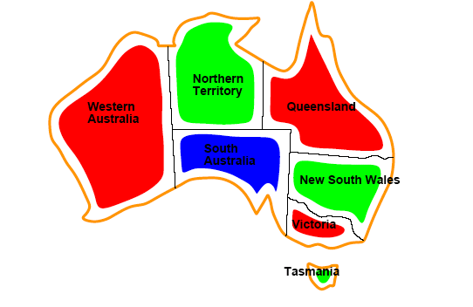
CSP Example: Map Coloring
Solution
Color assignments satisfying all constraints, e.g.
{WA=red, NT=green, Q=red, NSW=green, V=red, SA=blue, T=green}

Slide 11
Example: Task Scheduling
T1 must be done during T3
T2 must be achieved before T1 starts
T2 must overlap with T3
T4 must start after T1 is complete
Are the constraints compatible?
Allocate a time slot to each task

Slide 12
Example: Street Puzzle
1
2
3
4
5
Ni = {English, Spaniard, Japanese, Italian, Norwegian}
Ci = {Red, Green, White, Yellow, Blue}
Di = {Tea, Coffee, Milk, Fruit-juice, Water}
Ji = {Painter, Sculptor, Diplomat, Violinist, Doctor}
Ai = {Dog, Snails, Fox, Horse, Zebra}

Slide 13
Example: Street Puzzle
1
2
3
4
5
Ni = {English, Spaniard, Japanese, Italian, Norwegian}
Ci = {Red, Green, White, Yellow, Blue}
Di = {Tea, Coffee, Milk, Fruit-juice, Water}
Ji = {Painter, Sculptor, Diplomat, Violinist, Doctor}
Ai = {Dog, Snails, Fox, Horse, Zebra}
The Englishman lives in the Red house
The Spaniard has a Dog
The Japanese is a Painter
The Italian drinks Tea
The Norwegian lives in the first house on the left
The owner of the Green house drinks Coffee
The Green house is on the right of the White house
The Sculptor breeds Snails
The Diplomat lives in the Yellow house
The owner of the middle house drinks Milk
The Norwegian lives next door to the Blue house
The Violinist drinks Fruit juice
The Fox is in the house next to the Doctor’s
The Horse is next to the Diplomat’s
Who owns the Zebra?
Who drinks Water?

Slide 14
Varieties of CSPs
Discrete variables
Finite domains; size d ⇒O(d^{n}) complete assignments.
E.g. Boolean CSPs: Boolean satisfiability (NP-complete).
Infinite domains (integers, strings, etc.)
E.g. job scheduling, variables are start/end days for each job
Need a constraint language e.g StartJob₁ +5 ≤ StartJob₃.
Infinitely many solutions
Linear constraints: solvable
Nonlinear: no general algorithm
Continuous variables
e.g. building an airline schedule or class schedule.
Linear constraints solvable in polynomial time by LP methods.

Slide 15
Varieties of constraints
Unary constraints involve a single variable.
e.g. SA ≠ green
Binary constraints involve pairs of variables.
e.g. SA ≠ WA
Higher-order constraints involve 3 or more variables.
Professors A, B,and C cannot be on a committee together
Can always be represented by multiple binary constraints
Preference (soft constraints)
e.g. red is better than green often can be represented by a cost for each variable assignment
combination of optimization with CSPs

Slide 16
Commutativity of CSP
The order in which values are assigned
to variables is irrelevant to the final
assignment, hence:
Generate successors of a node by considering assignments for only one variable
Do not store the path to node

Slide 17
Constraint Graph
Constraint Graph (aka Hypergraph)
Represent relations among constraints
Vertices
Variables
Edges
Constraints

Slide 18
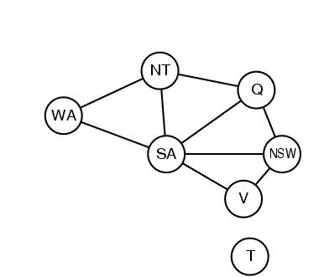
Constraint Graph
Constraint graph
Nodes are variables
Arcs are binary constraints
Graph can be used to simply search
WA≠NT, WA≠SA, NT≠SA, NT≠Q, SA≠Q, SA≠NSW, SA≠V,Q≠NSW, NSW≠V

Slide 19
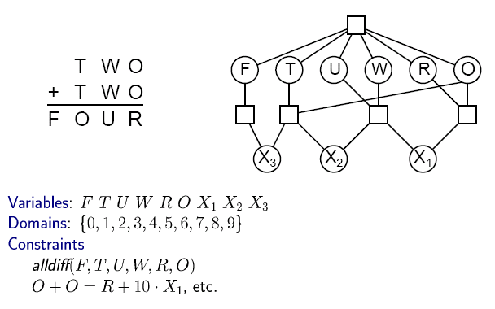

CSP Example: Cryptharithmetic puzzle

Slide 20
CSP as a standard search problem
Solution is found at depth n (if there are n variables).
Consider using BFS
Branching factor b at the top level is nd
At next level is (n-1)d
….
end up with n!d^{n} leaves even though there are only d^{n} complete assignments!

Slide 21
Backtracking search
Similar to Depth-first search
Chooses values for one variable at a time and backtracks when a variable has no legal values left to assign.
Uninformed algorithm
No good general performance

Slide 22
Backtracking search
function BACKTRACKING-SEARCH(csp) return a solution or failure
return RECURSIVE-BACKTRACKING({} , csp)
function RECURSIVE-BACKTRACKING(assignment, csp) return a solution or failure
if assignment is complete then return assignment
var ← SELECT-UNASSIGNED-VARIABLE(VARIABLES[csp],assignment,csp)
for each value in ORDER-DOMAIN-VALUES(var, assignment, csp) do
if value is consistent with assignment according to CONSTRAINTS[csp] then
add {var=value} to assignment
result ← RRECURSIVE-BACTRACKING(assignment, csp)
if result ≠ failure then return result
remove {var=value} from assignment
return failure

Slide 23
→ Backtracking Search
empty assignment
1st variable
2nd variable
3rd variable
Assignment = {}

Slide 24
→ Backtracking Search
empty assignment
1st variable
2nd variable
3rd variable
Assignment = {(var1=v11)}

Slide 25
→ Backtracking Search
empty assignment
1st variable
2nd variable
3rd variable
Assignment = {(var1=v11),(var2=v21)}

Slide 26
→ Backtracking Search
empty assignment
1st variable
2nd variable
3rd variable
Assignment = {(var1=v11),(var2=v21),(var3=v31)}

Slide 27
→ Backtracking Search
empty assignment
1st variable
2nd variable
3rd variable
Assignment = {(var1=v11),(var2=v21),(var3=v32)}

Slide 28
→ Backtracking Search
empty assignment
1st variable
2nd variable
3rd variable
Assignment = {(var1=v11),(var2=v22)}

Slide 29
→ Backtracking Search
empty assignment
1st variable
2nd variable
3rd variable
Assignment = {(var1=v11),(var2=v22),(var3=v31)}

Slide 30
Backtracking example

Slide 31
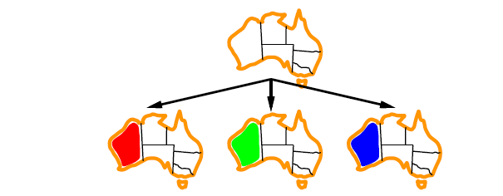
Backtracking example

Slide 32
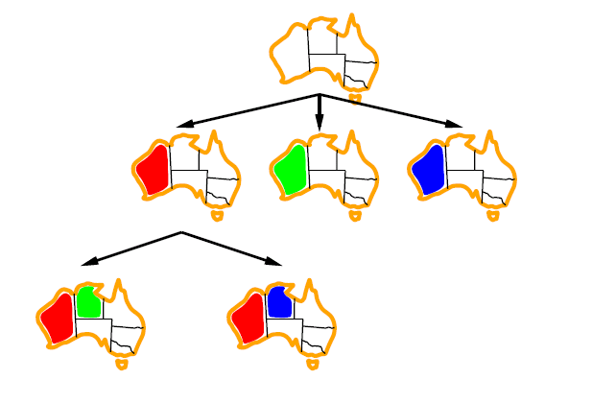
Backtracking example

Slide 33
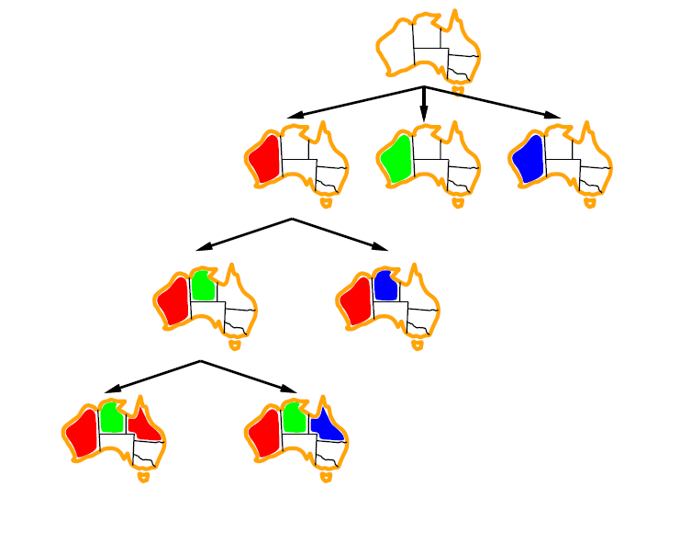
Backtracking example

Slide 34
Improving CSP efficiency
Previous improvements on uninformed search
→ introduce heuristics
For CSPS, general-purpose methods can give large gains in speed, e.g.,
Which variable should be assigned next?
In what order should its values be tried?
Can we detect inevitable failure early?
Can we take advantage of problem structure?
Note: CSPs are somewhat generic in their formulation, and so the heuristics are more general compared to methods in Chapter 4

Slide 35
Backtracking search
function BACKTRACKING-SEARCH(csp) return a solution or failure
return RECURSIVE-BACKTRACKING({} , csp)
function RECURSIVE-BACKTRACKING(assignment, csp) return a solution or failure
if assignment is complete then return assignment
var ← SELECT-UNASSIGNED-VARIABLE(VARIABLES[csp],assignment,csp)
for each value in ORDER-DOMAIN-VALUES(var, assignment, csp) do
if value is consistent with assignment according to CONSTRAINTS[csp] then
add {var=value} to assignment
result ← RRECURSIVE-BACTRACKING(assignment, csp)
if result ≠ failure then return result
remove {var=value} from assignment
return failure

Slide 36

Minimum remaining values (MRV)
var ← SELECT-UNASSIGNED-VARIABLE(VARIABLES[csp],assignment,csp)
A.k.a. most constrained variable heuristic
Heuristic Rule: choose variable with the fewest legal moves
e.g., will immediately detect failure if X has no legal values

Slide 37

Degree heuristic for the initial variable
Heuristic Rule: select variable that is involved in the largest number of constraints on other unassigned variables.
Degree heuristic can be useful as a tie breaker.
In what order should a variable’s values be tried?

Slide 38
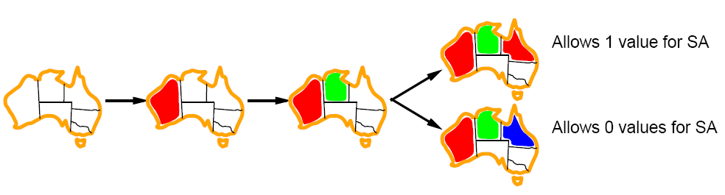
Least constraining value for value-ordering
Least constraining value heuristic
Heuristic Rule: given a variable choose the least constraining value
leaves the maximum flexibility for subsequent variable assignments

Slide 39
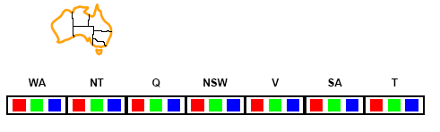
Forward checking
Can we detect inevitable failure early?
And avoid it later?
Forward checking idea: keep track of remaining legal values for unassigned variables.
Terminate search when any variable has no legal values.

Slide 40
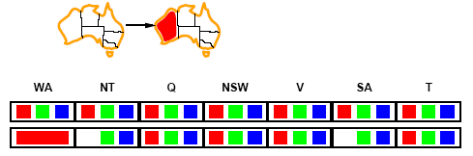
Forward checking
Assign {WA=red}
Effects on other variables connected by constraints to WA
NT can no longer be red
SA can no longer be red

Slide 41
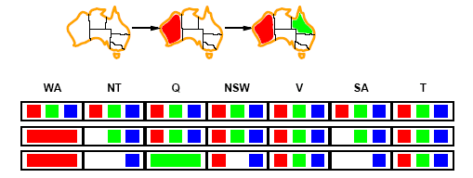
Forward checking
Assign {Q=green}
Effects on other variables connected by constraints with WA
NT can no longer be green
NSW can no longer be green
SA can no longer be green
MRV heuristic would automatically select NT or SA next

Slide 42
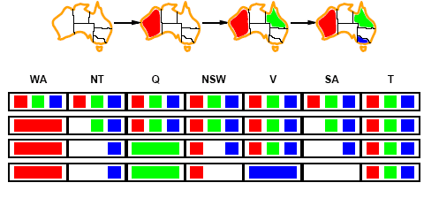
Forward checking
If V is assigned blue
Effects on other variables connected by constraints with WA
NSW can no longer be blue
SA is empty
FC has detected that partial assignment is inconsistent with the constraints and backtracking can occur.

Slide 43
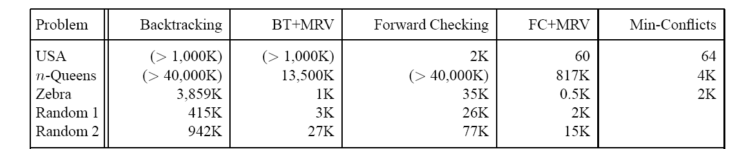
Comparison of CSP algorithms on different problems
Median number of consistency checks over 5 runs to solve problem
Parentheses -> no solution found
USA: 4 coloring
n-queens: n = 2 to 50
Zebra: see exercise 5.13

Slide 44
Summary
Constraint Satisfaction Problem
Backtracking Algorithm
Minimum remaining values
Degree heuristics
Least constraining values
Forward checking

Slide 45
What I want you to do
Review Chapter 6
Work on your assignment
Get your project proposal ready

